Slide 1
Smart Bin Project
Volodymyr & William

Slide 2
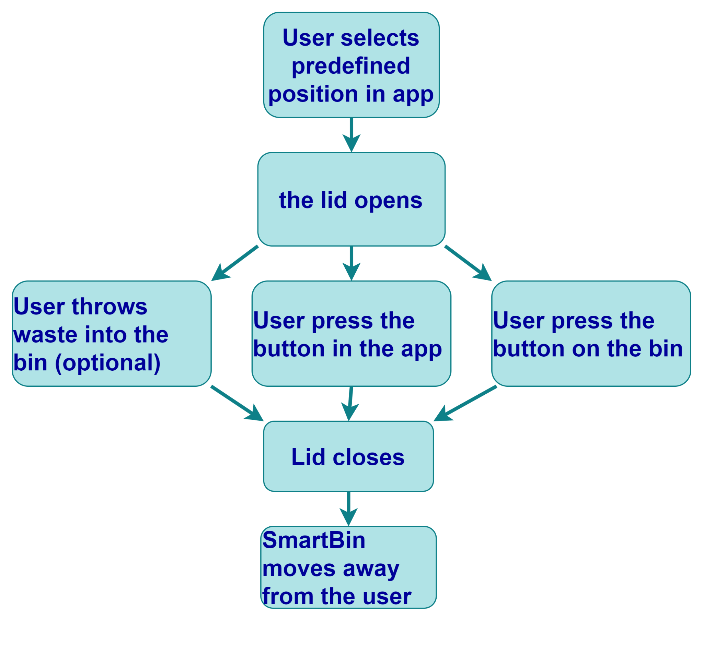
SmartBin workflow
User Selects Position in App
The user opens the SmartBin app and selects a predefined lid position (partial or full).
Lid Opens
The SmartBin’s lid opens automatically to the selected position, allowing easy access for waste disposal.
User Disposes of Waste
The user can throw waste into the bin while the lid is open.
User Confirms Closing
The user presses the "Close Lid" button in the app or the physical button on the bin.
Automatic recognition of waste and closure (Optional)
Lid Closes
The lid closes securely, containing the waste.
SmartBin Moves Away
After closing, the SmartBin autonomously moves away from the user, promoting cleanliness and efficient waste management.

Slide 3
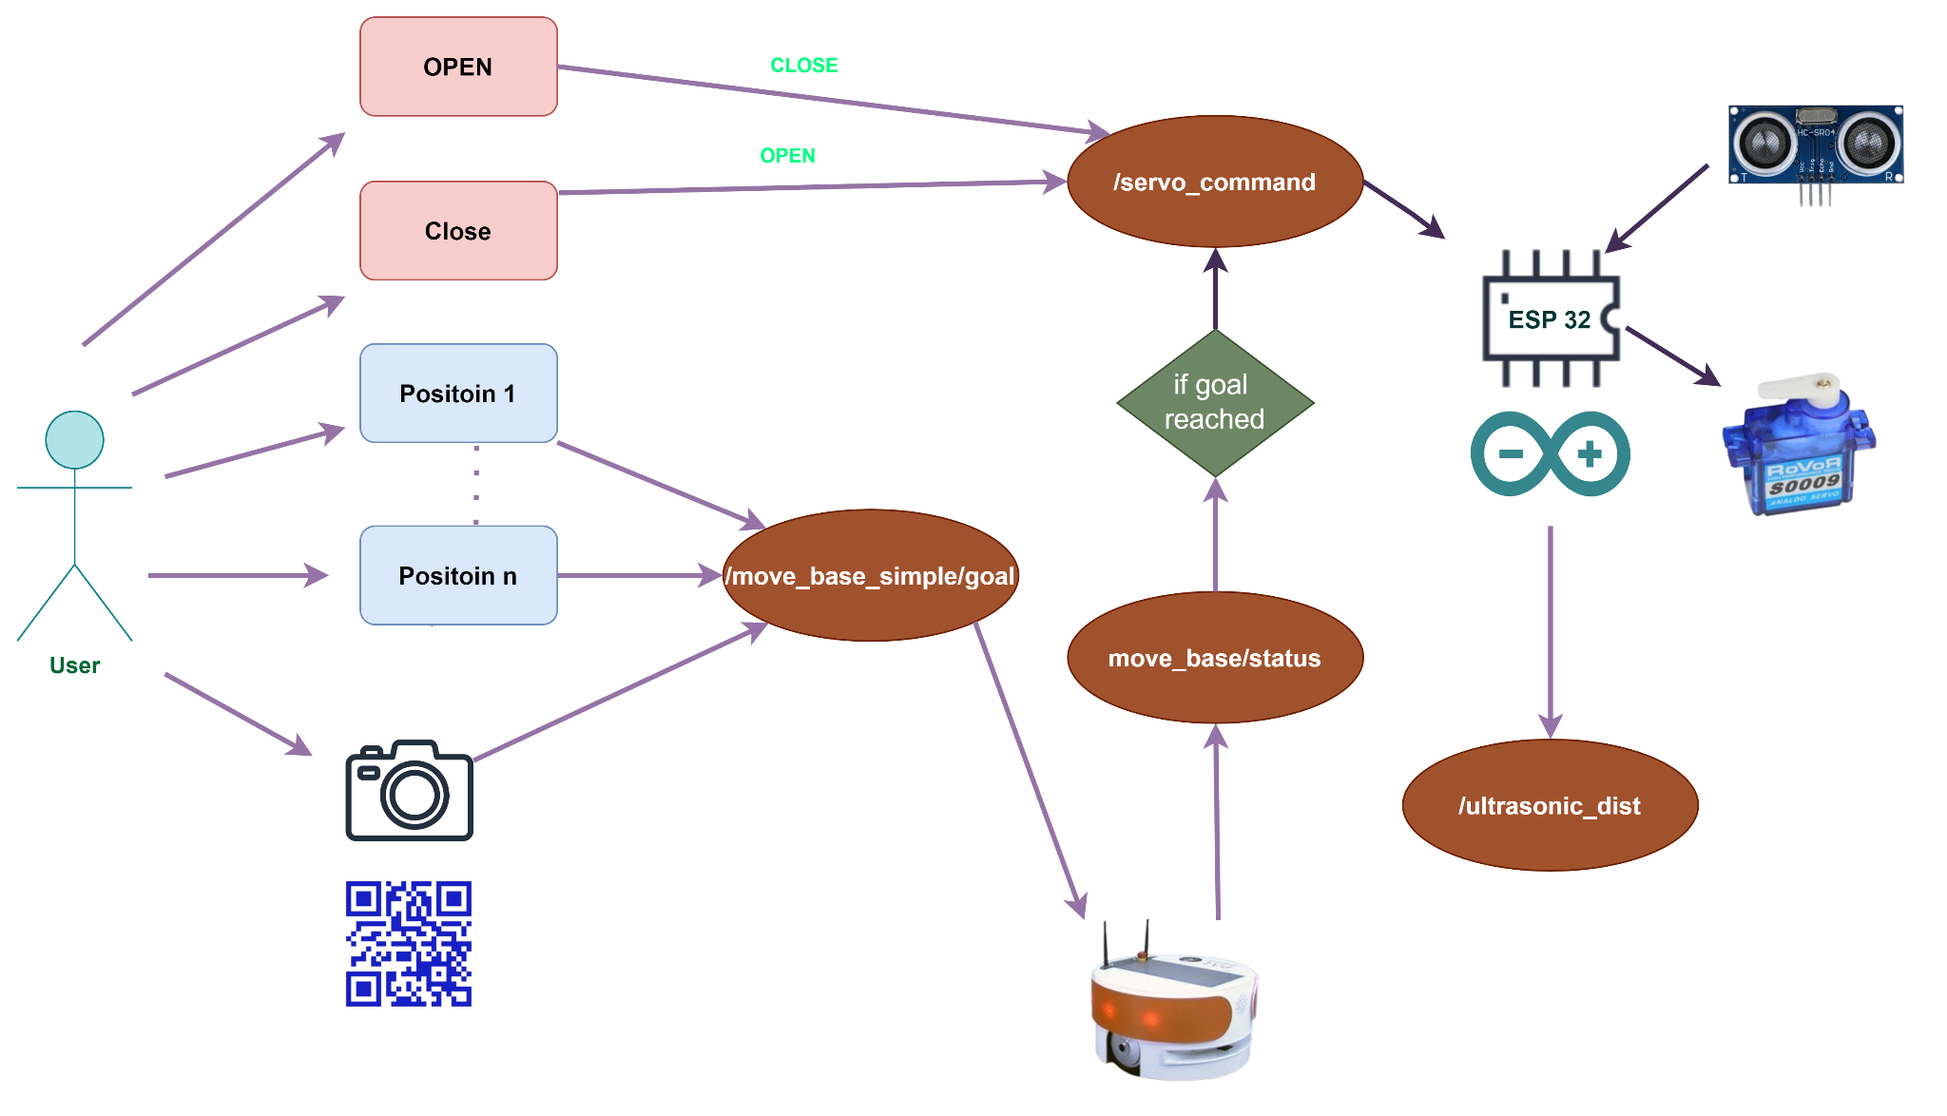

Slide 4
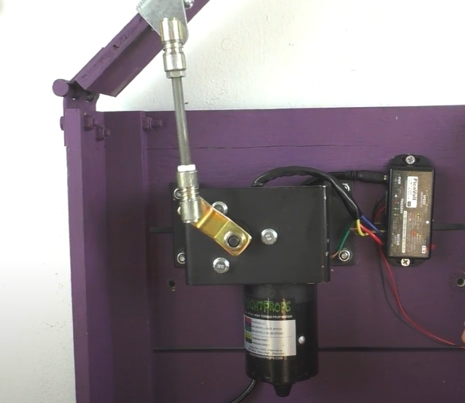
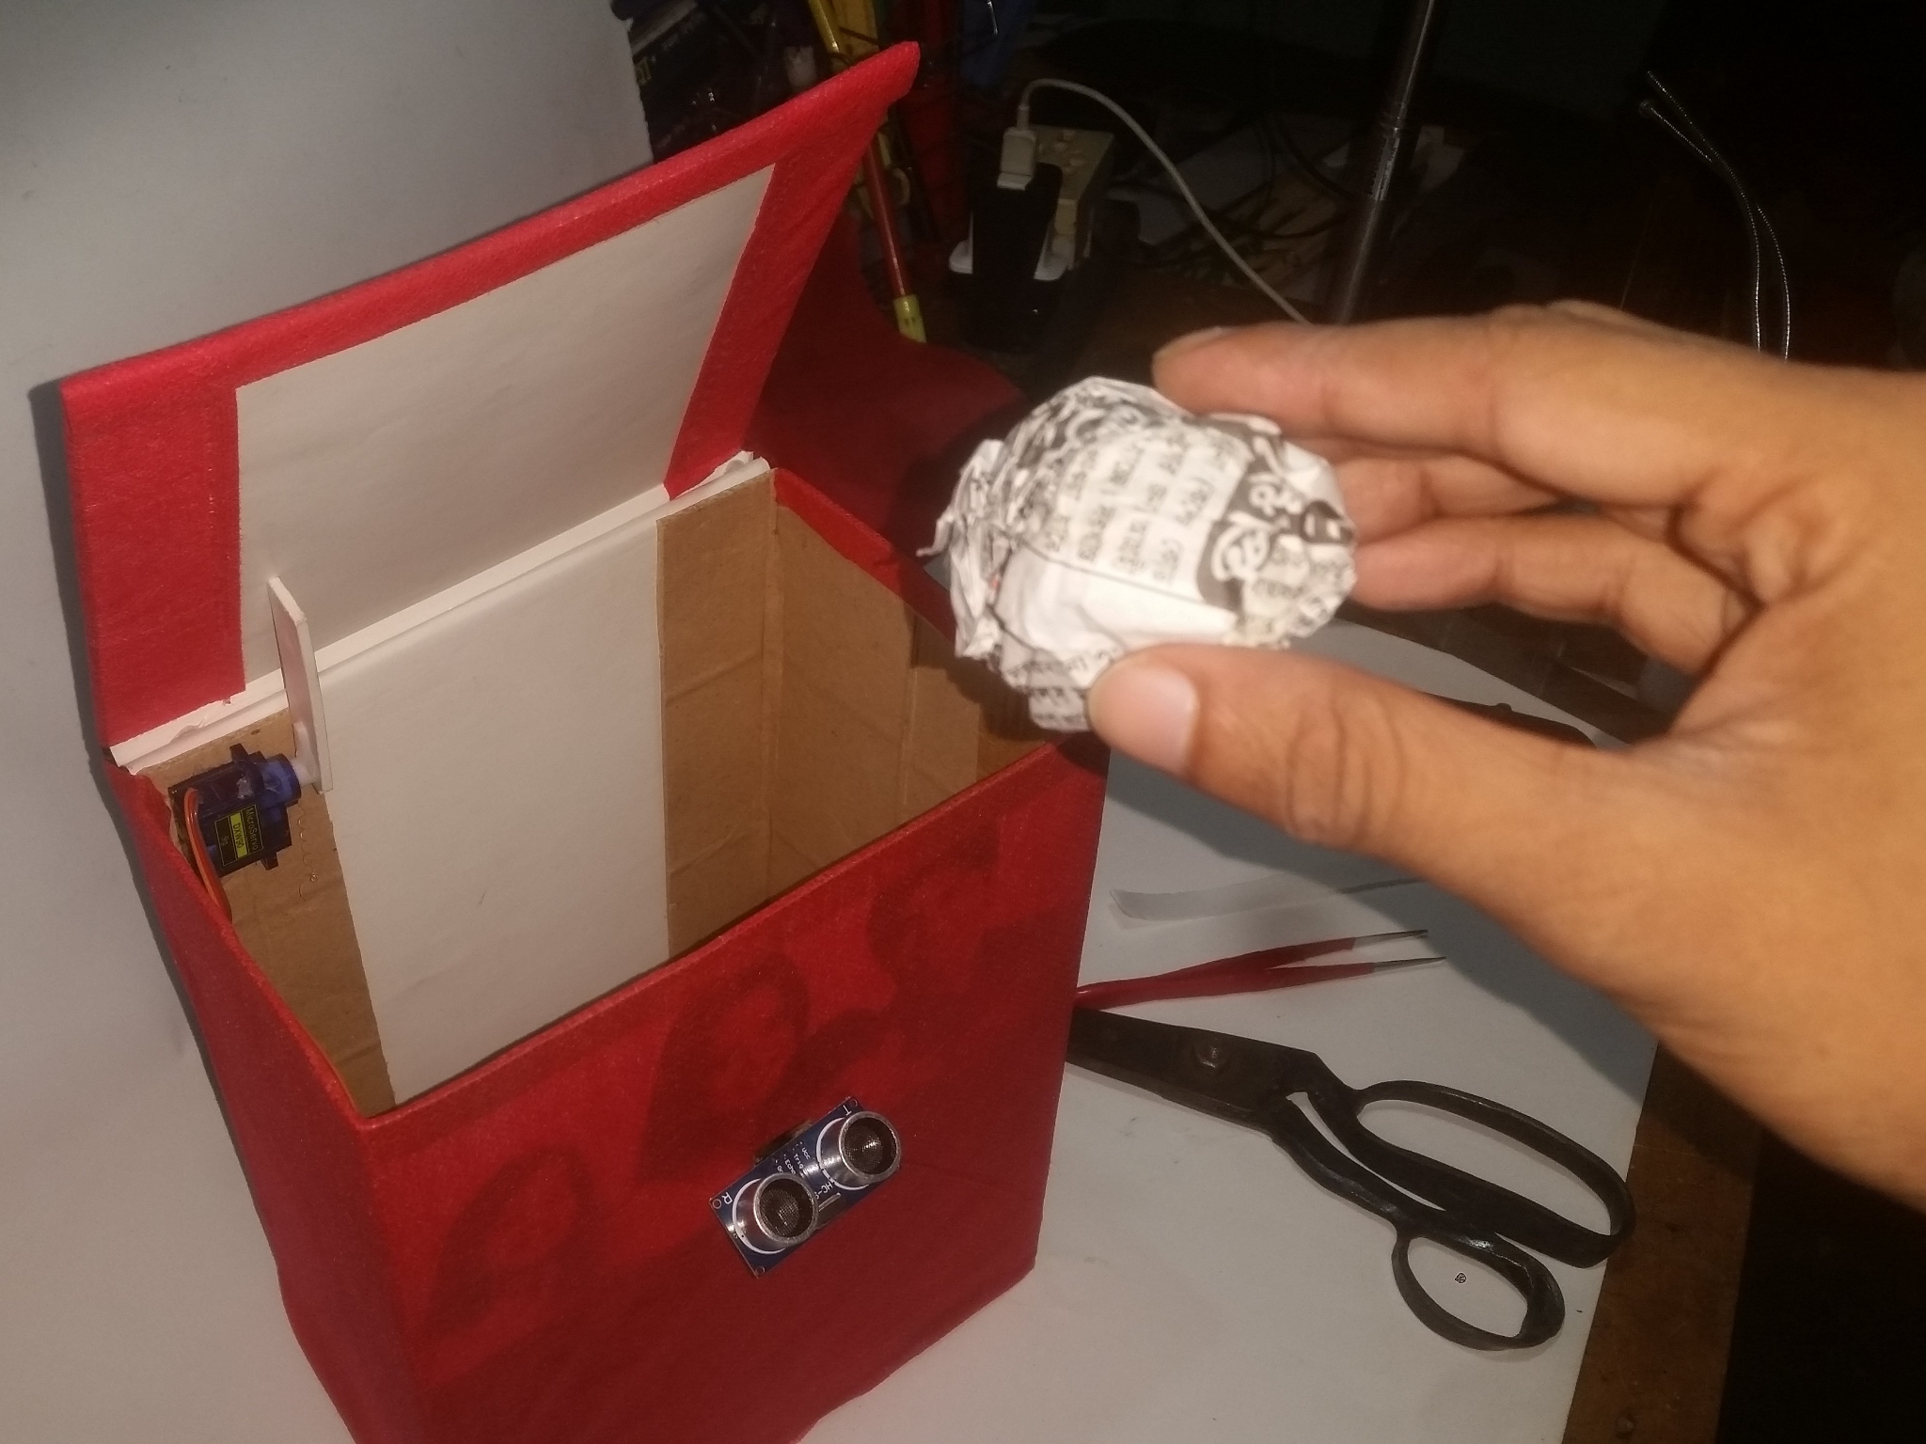
Lid opening concept

Slide 5
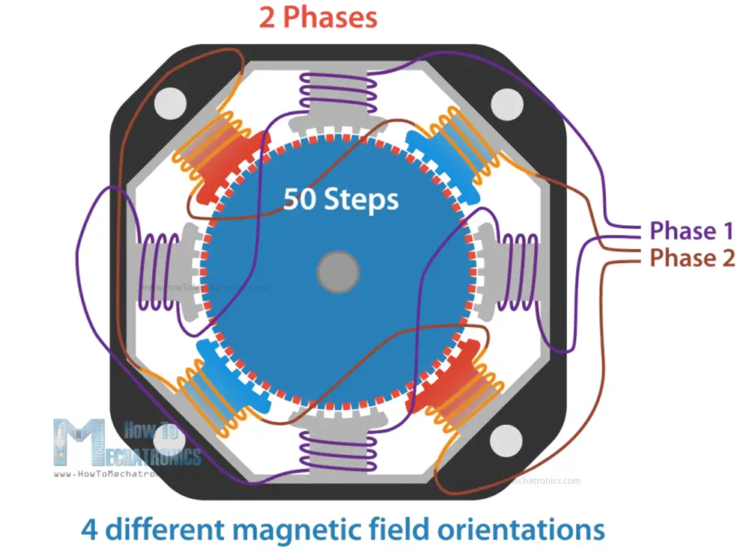
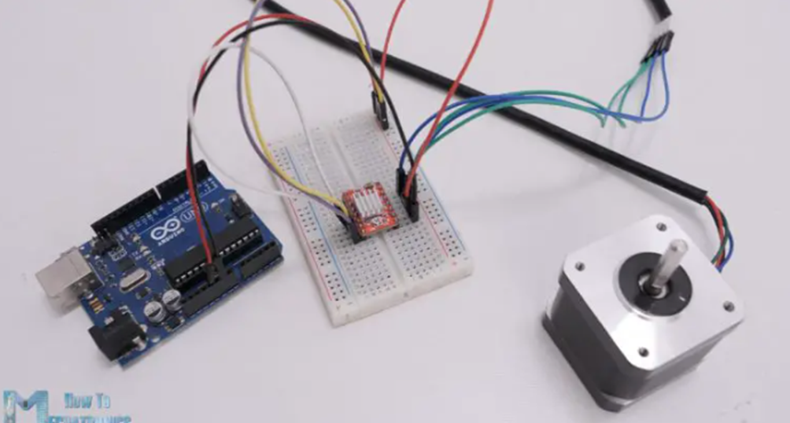
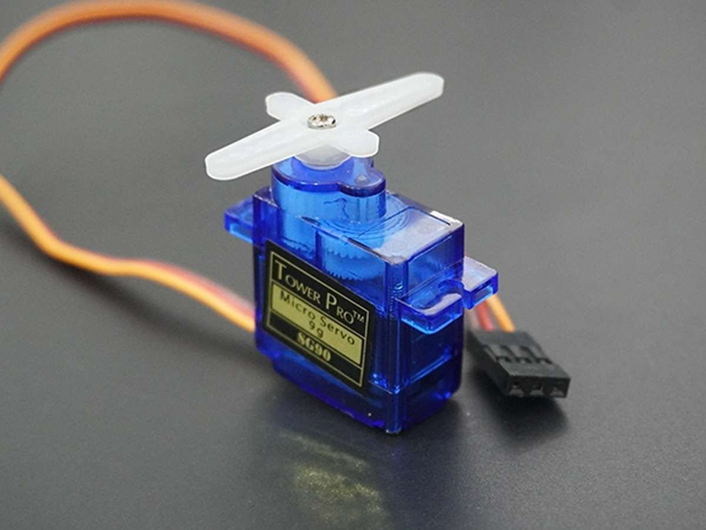
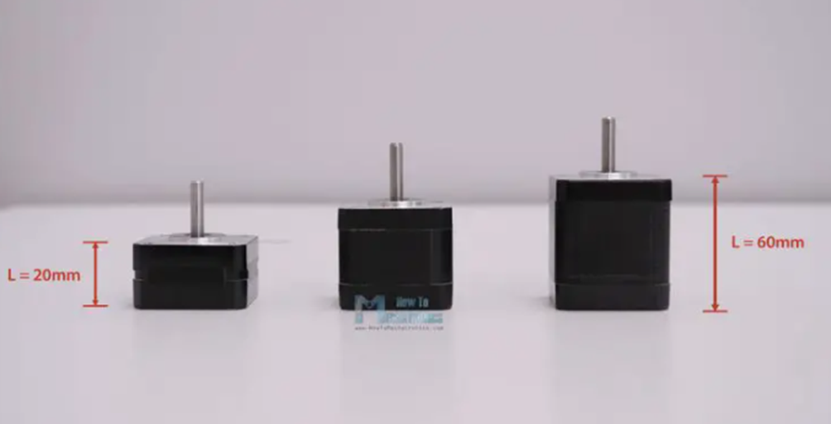
Lid opening concept
Stepping motor
pros
Torque at Low Speeds
No Need for Encoders
Simple Control
Precise Position Control
cons
low speed
Energy Consumption
Servo motor
pros
Variable Speed and Torque
Closed-Loop Control
High Efficiency
Smooth Motion
cons
Limited Holding Torque at Standstill
Complex Control

Slide 6
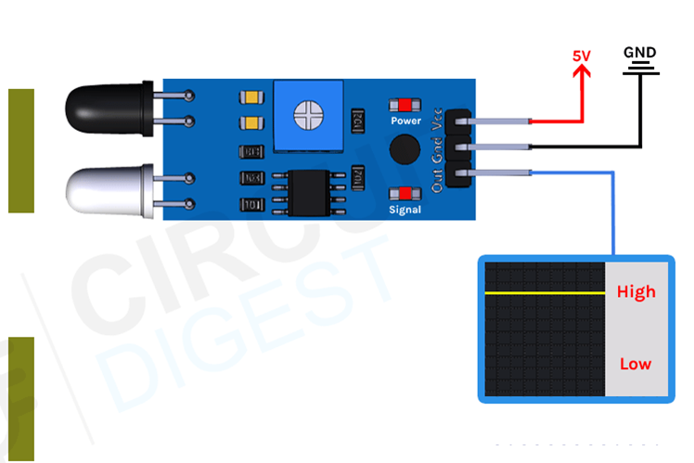
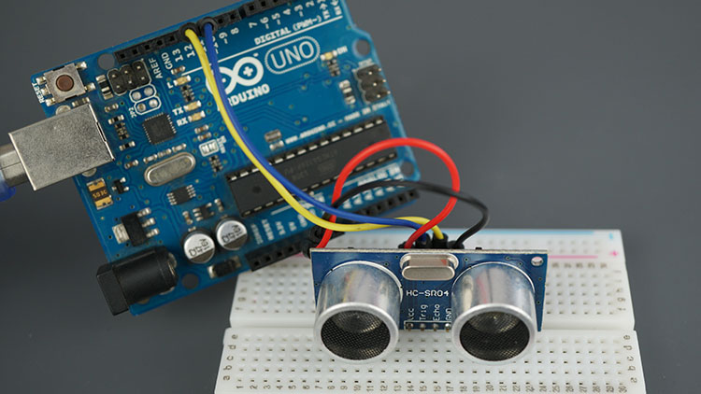
Trash detection
IR sensor
pros
Fast Response Time
cons
Reflective Surface Dependence
Sensitivity to Ambient Light
Ultrasonic sensor
pros
Not Affected by Light
Versatile Detection
cons
Slow Response Time

Slide 7
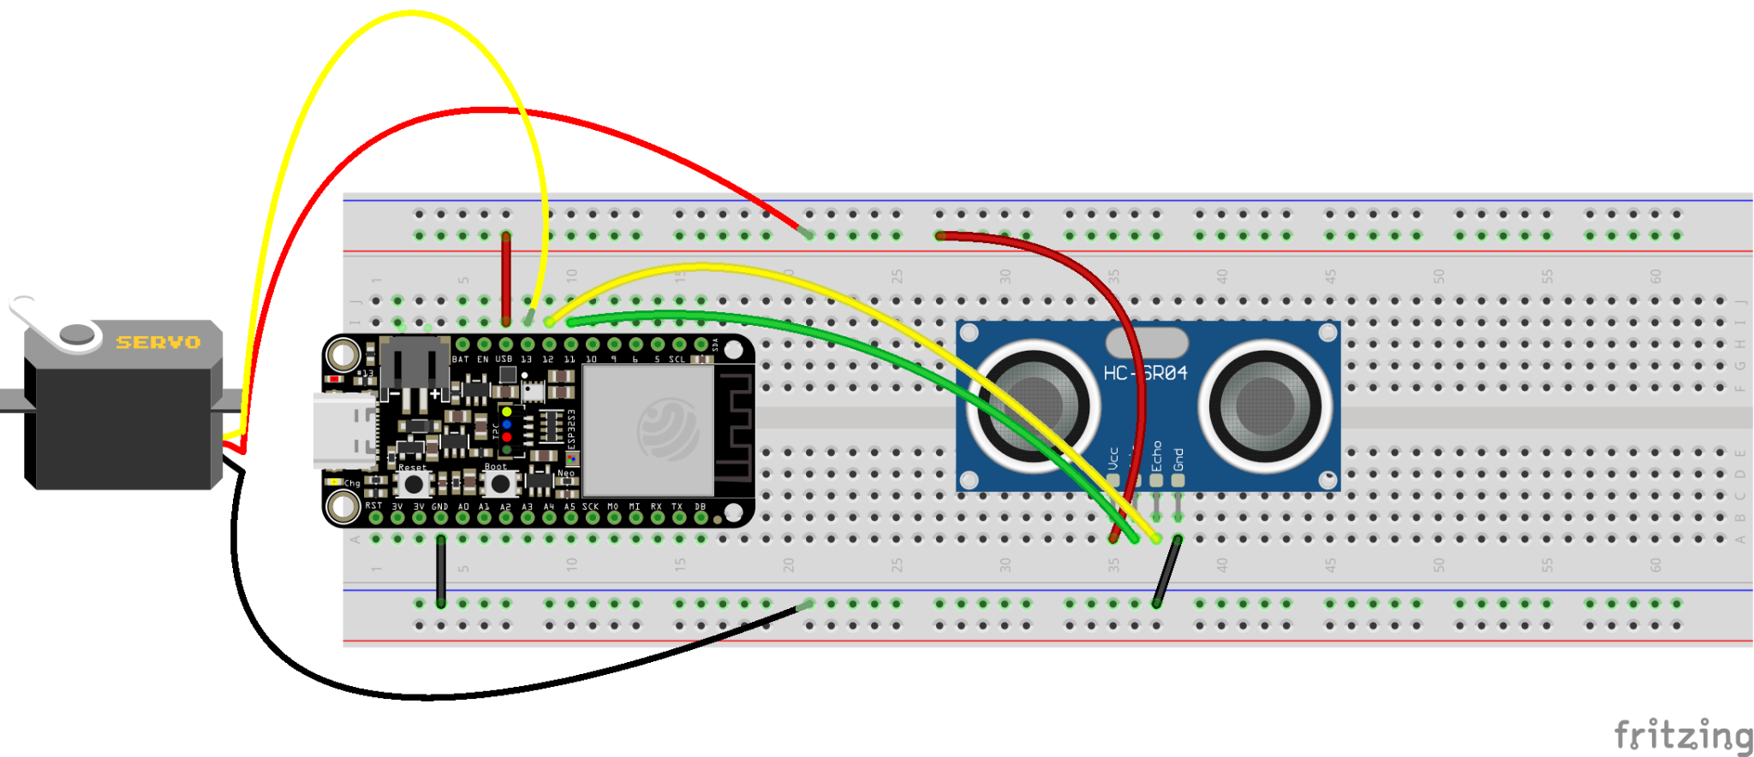
Schematic

Slide 8
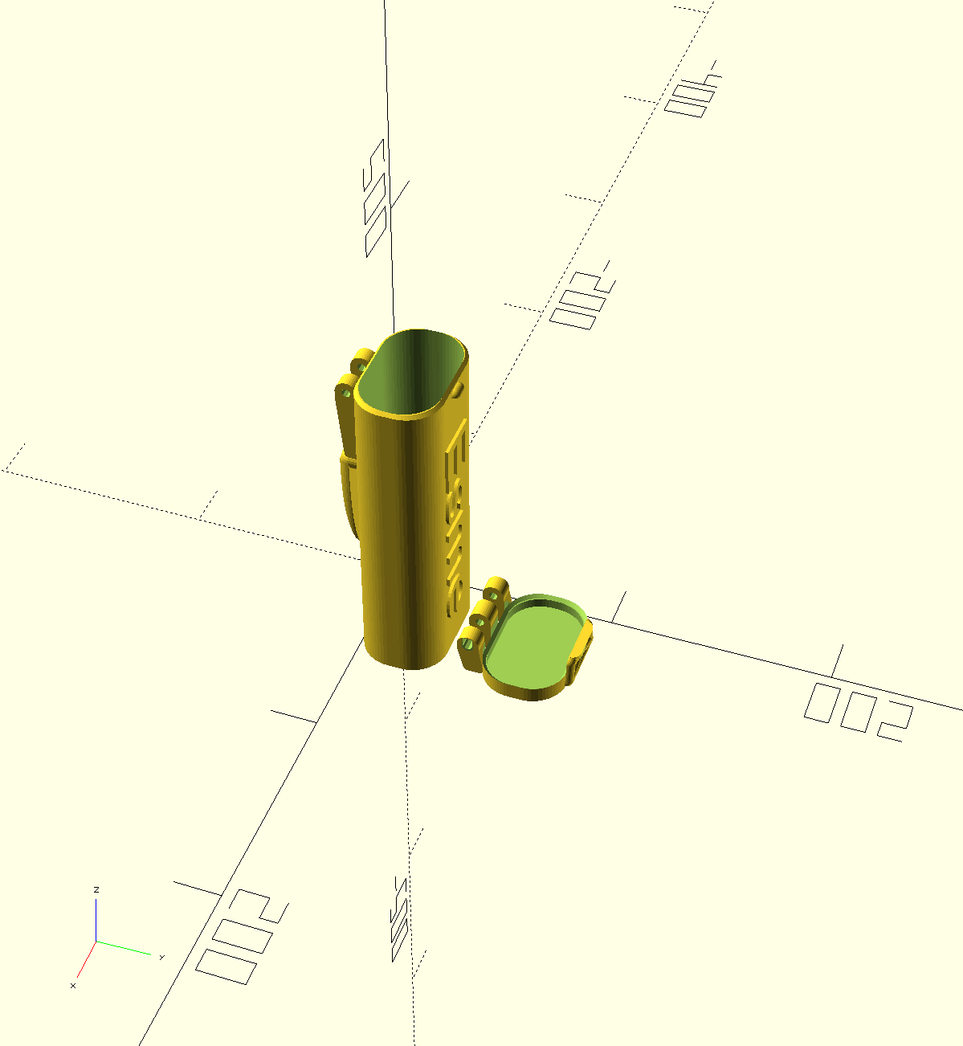
3d-fabrication (openSCAD)

Slide 9
Iteration 1 — Tasks
prepare mid-term presentation
node-RED logics:
Tiago can navigate to hard coded place by clicking the button
User can set goal to robot via QR code
user can open the lid by clicking the button in the app
initiate github repo
servo motor:
connected to Arduino
use ROS to modify its state
ultrasonic sensor:
connected to Arduino
use ROS to receive its data
3D-fabrication model:
put them altogether

Slide 10
Iteration 2 — Tasks
prepare final presentation (short demo)
node-RED logics:
bind QR codes to the hard coded places
button:
connected to Arduino
use ROS to receive its data
3D-fabrication model:
refine the model

Slide 11
Thank you for listening

